Slide 1
Web Search and Mining
Lecture 12: Language Models

Slide 2
Recap
Probabilistic models:
  Binary independence model
  Bayesian networks for IR
  Language models

Slide 3
This lecture
The Language Model Approach to IR
  Basic query generation model
  Alternative models

Slide 4


Standard Probabilistic IR
Information need
d1
matching
d2
query
…
dn
document collection

Slide 5




IR based on Language Model (LM)
Information need
d1
generation
d2
query
…
…
A common search heuristic is to use words that you expect to find in matching documents as your query.
The LM approach directly exploits that idea!
dn
document collection

Slide 6
Formal Language (Model)
Traditional generative model: generates strings
  Finite state machines or regular grammars, etc.
Example:
I wish
I wish I wish
I wish I wish I wish
I
wish
I wish I wish I wish I wish
…
*wish I wish

Slide 7
Stochastic Language Models
Models probability of generating strings in the language (commonly all strings over alphabet ∑)
Model M
0.2 the
0.1 a
0.01 man
0.01 woman
0.03 said
0.02 likes
…
the
man
likes
the
woman
0.2
0.01
0.02
0.2
0.01
multiply
P(s | M) = 0.00000008

Slide 8
Stochastic Language Models
Model probability of generating any string
Model M1
Model M2
0.2 the
0.0001 class
0.03 sayst
0.02 pleaseth
0.1 yon
0.01 maiden
0.0001 woman
0.2 the
0.01 class
0.0001 sayst
0.0001 pleaseth
0.0001 yon
0.0005 maiden
0.01 woman
the
class
pleaseth
yon
maiden
0.2
0.01
0.0001
0.0001
0.0005
0.2
0.0001
0.02
0.1
0.01
P(s|M2) > P(s|M1)

Slide 9
Stochastic Language Models
A statistical model for generating text
  Probability distribution over strings in a given language
M
P ( | M )
= P ( | M )
P ( | M, )
P ( | M, )
P ( | M, )

Slide 10
Unigram and higher-order models
Unigram Language Models
Bigram (generally, n-gram) Language Models
Other Language Models
  Grammar-based models (PCFGs), etc.
    Probably not the first thing to try in IR
P ( )
= P ( )
P ( | )
P ( | )
P ( | )
Easy.
Effective!
P ( ) P ( ) P ( ) P ( )
P ( ) P ( | ) P ( | ) P ( | )

Slide 11
Using Language Models in IR
Treat each document as the basis for a model (e.g., unigram sufficient statistics)
Rank document d based on P(d | q)
P(d | q) = P(q | d) x P(d) / P(q)
  P(q) is the same for all documents, so ignore
  P(d) [the prior] is often treated as the same for all d
    But we could use criteria like authority, length, genre
  P(q | d) is the probability of q given d’s model
Very general formal approach

Slide 12
The fundamental problem of LMs
Usually we don’t know the model M
  But have a sample of text representative of that model
Estimate a language model from a sample
Then compute the observation probability
P ( | M ( ) )
M

Slide 13
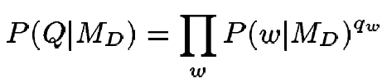
Language Models for IR
Query Likelihood Model
Language Modeling Approaches
  Attempt to model query generation process
  Documents are ranked by the probability that a query would be observed as a random sample from the respective document model
    Multinomial approach

Slide 14
Retrieval based on probabilistic LM
Query Likelihood Model
Treat the generation of queries as a random process.
Approach
  Infer a language model for each document.
  Estimate the probability of generating the query according to each of these models.
  Rank the documents according to these probabilities.
  Usually a unigram estimate of words is used
    Some work on bigrams, paralleling van Rijsbergen

Slide 15
Retrieval based on probabilistic LM
Query Likelihood Model
Intuition
  Users …
    Have a reasonable idea of terms that are likely to occur in documents of interest.
    They will choose query terms that distinguish these documents from others in the collection.
Collection statistics …
  Are integral parts of the language model.
  Are not used heuristically as in many other approaches.
    In theory. In practice, there’s usually some wiggle room for empirically set parameters

Slide 16
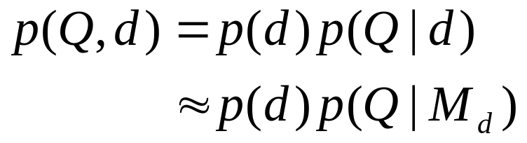
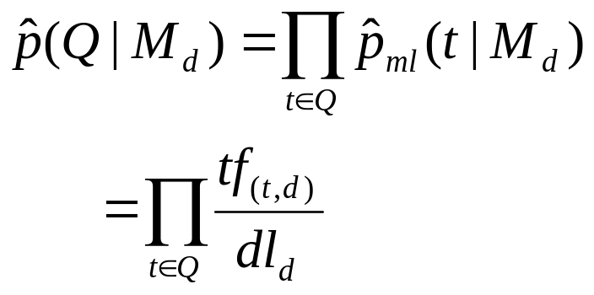



Query generation probability
Query Likelihood Model
Ranking formula
The probability of producing the query given the language model of document d using MLE is:
Unigram assumption:
Given a particular language model, the query terms occur independently
: language model of document d
: raw tf of term t in document d
: total number of tokens in document d

Slide 17

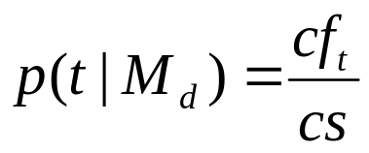
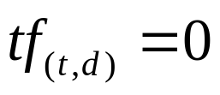


Insufficient data
Query Likelihood Model
Zero probability
  May not wish to assign a probability of zero to a document that is missing one or more of the query terms [gives conjunction semantics]
General approach
  A non-occurring term is possible, but no more likely than would be expected by chance in the collection.
  If ,
: raw count of term t in the collection
: raw collection size(total number of tokens in the collection)

Slide 18
Insufficient data
Query Likelihood Model
Zero probabilities spell disaster
  We need to smooth probabilities
    Discount nonzero probabilities
    Give some probability mass to unseen things
There’s a wide space of approaches to smoothing probability distributions to deal with this problem, such as adding 1, ½ or ε to counts, Dirichlet priors, discounting, and interpolation
A simple idea that works well in practice is to use a mixture between the document multinomial and the collection multinomial distribution

Slide 19
Mixture model
Query Likelihood Model
P(w|d) = λP_{mle}(w|M_{d}) + (1 – λ)P_{mle}(w|M_{c})
Mixes the probability from the document with the general collection frequency of the word.
Correctly setting λ is very important
A high value of λ makes the search “conjunctive-like” – suitable for short queries
A low value is more suitable for long queries
Can tune λ to optimize performance
  Perhaps make it dependent on document size (cf. Dirichlet prior or Witten-Bell smoothing)

Slide 20
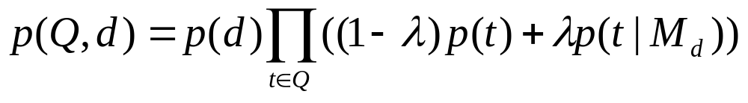
Basic mixture model summary
Query Likelihood Model
General formulation of the LM for IR
  The user has a document in mind, and generates the query from this document.
  The equation represents the probability that the document that the user had in mind was in fact this one.
general language model
individual-document model

Slide 21
Example
Query Likelihood Model
Document collection (2 documents)
  d₁: Xerox reports a profit but revenue is down
  d₂: Lucent narrows quarter loss but revenue decreases further
Model: MLE unigram from documents; λ = ½
Query: revenue down
  P(Q|d₁) = [(1/8 + 2/16)/2] x [(1/8 + 1/16)/2]
  = 1/8 x 3/32 = 3/256
  P(Q|d₂) = [(1/8 + 2/16)/2] x [(0 + 1/16)/2]
  = 1/8 x 1/32 = 1/256
Ranking: d₁ > d₂

Slide 22
Ponte and Croft Experiments
Query Likelihood Model
Data
  TREC topics 202-250 on TREC disks 2 and 3
    Natural language queries consisting of one sentence each
  TREC topics 51-100 on TREC disk 3 using the concept fields
    Lists of good terms
<num>Number: 054
<dom>Domain: International Economics
<title>Topic: Satellite Launch Contracts
<desc>Description:
… </desc>
<con>Concept(s):
Contract, agreement
Launch vehicle, rocket, payload, satellite
Launch services, … </con>

Slide 23
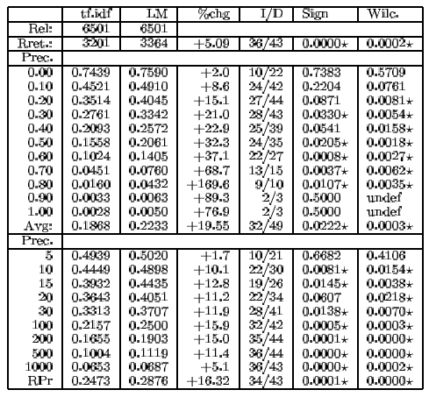
Precision/recall results 202-250
Query Likelihood Model

Slide 24
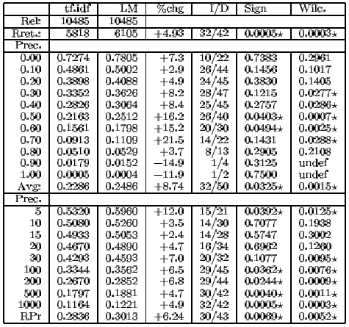
Precision/recall results 51-100
Query Likelihood Model

Slide 25
LM vs. Prob. Model for IR
Query Likelihood Model
The main difference is whether “Relevance” figures explicitly in the model or not
  LM approach attempts to do away with modeling relevance
LM approach assumes that documents and expressions of information problems are of the same type
Computationally tractable, intuitively appealing

Slide 26
LM vs. Prob. Model for IR
Query Likelihood Model
Problems of basic LM approach
  Assumption of equivalence between document and information problem representation is unrealistic
  Very simple models of language
  Relevance feedback is difficult to integrate, as are user preferences, and other general issues of relevance
  Can’t easily accommodate phrases, passages, Boolean operators
Current extensions focus on putting relevance back into the model, etc.

Slide 27


Extension: 3-level model
Query Likelihood Model
3-level model
  Whole collection model ( )
  Specific-topic model; relevant-documents model ( )
  Individual-document model ( )
Relevance hypothesis
  A request(query; topic) is generated from a specific-topic model { , }.
  If a document is relevant to the topic, the same model will apply to the document.
    It will replace part of the individual-document model in explaining the document.
  The probability of relevance of a document
    The probability that this model explains part of the document
    The probability that the { , , } combination is better than the { , } combination

Slide 28





3-level model
Query Likelihood Model
Information need
d1
d2
generation
query
…
…
…
dn
document collection

Slide 29




Alternative Models of Text Generation
Extended Language Models
Searcher
Query Model
Query
Is this the same model?
Writer
Doc Model
Doc

Slide 30


Retrieval Using Language Models
Extended Language Models
Query
Query Model
1
3
2
Doc
Doc Model
Retrieval: Query likelihood (1), Document likelihood (2), Model comparison (3)

Slide 31
Query Likelihood
Extended Language Models
P(Q|D_{m})
Major issue is estimating document model
  i.e. smoothing techniques instead of tf.idf weights
Good retrieval results
  e.g. UMass, BBN, Twente, CMU
Problems dealing with relevance feedback, query expansion, structured queries

Slide 32
Document Likelihood
Extended Language Models
Rank by likelihood ratio P(D|R)/P(D|NR)
  treat as a generation problem
  P(w|R) is estimated by P(w|Q_{m})
  Q_{m} is the query or relevance model
  P(w|NR) is estimated by collection probabilities P(w)
Issue is estimation of query model
  Treat query as generated by mixture of topic and background
  Estimate relevance model from related documents (query expansion)
  Relevance feedback is easily incorporated
Good retrieval results
  e.g. UMass at SIGIR 01
  inconsistent with heterogeneous document collections

Slide 33
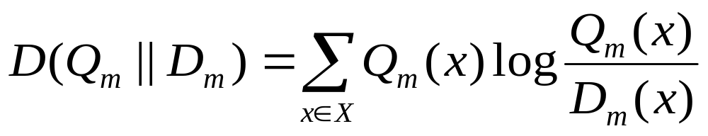
Model Comparison
Extended Language Models
Estimate query and document models and compare
Suitable measure is KL divergence D(Q_{m}||D_{m})
  equivalent to query-likelihood approach if simple empirical distribution used for query model
More general risk minimization framework has been proposed
  Zhai and Lafferty 2001
Better results than query-likelihood or document-likelihood approaches

Slide 34
Two-stage smoothing:
Another Reason for Smoothing
Extended Language Models
Query = “the algorithms for data mining”
d1: 0.04 0.001 0.02 0.002 0.003
d2: 0.02 0.001 0.01 0.003 0.004
p( “algorithms”|d1) = p(“algorithm”|d2)
p( “data”|d1) < p(“data”|d2)
p( “mining”|d1) < p(“mining”|d2)
But p(q|d1)>p(q|d2)!
We should make p(“the”) and p(“for”) less different for all docs.

Slide 35
Two-stage Smoothing
Extended Language Models
Stage-1
-Explain unseen words
-Dirichlet prior(Bayesian)
Stage-2
-Explain noise in query
-2-component mixture
μ
λ
c(w,d)
+μp(w|C)
P(w|d) =
(1-λ)
+ λp(w|U)
|d|
+μ

Slide 36
How can one do relevance feedback if using language modeling approach?
Relevance Feedback based on LM
Introduce a query model & treat feedback as query model updating
  Retrieval function:
    Query-likelihood => KL-Divergence
  Feedback:
    Expansion-based => Model-based

Slide 37





Expansion-based vs. Model-based
Relevance Feedback based on LM
Doc model
Document D
Scoring
Results
Query likelihood
Query Q
modify
Expansion-based
Feedback
Feedback Docs
Doc model
Document D
Scoring
KL-divergence
Results
Query model
Query Q
Model-based
Feedback
Feedback Docs
modify

Slide 38






Feedback as Model Interpolation
Relevance Feedback based on LM
Document D
Results
Query Q
Feedback Docs
F={d₁, d₂ , …, d_{n}}
α=0
α=1
Generative model
No feedback
Full feedback

Slide 39
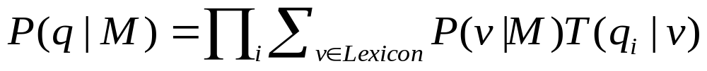
Translation model (Berger and Lafferty)
Translation Model
Basic LMs do not address issues of synonymy.
  Or any deviation in expression of information need from language of documents
A translation model lets you generate query words not in document via “translation” to synonyms etc.
  Or to do cross-language IR, or multimedia IR
  Basic LM Translation
  Need to learn a translation model (using a dictionary or via statistical machine translation)

Slide 40
Language models: pro & con
Novel way of looking at the problem of text retrieval based on probabilistic language modeling
    Conceptually simple and explanatory
    Formal mathematical model
    Natural use of collection statistics, not heuristics (almost…)
LMs provide effective retrieval and can be improved to the extent that the following conditions can be met
    Our language models are accurate representations of the data.
    Users have some sense of term distribution.*
      *Or we get more sophisticated with translation model

Slide 41
Comparison With Vector Space
There’s some relation to traditional tf.idf models:
  (unscaled) term frequency is directly in model
  the probabilities do length normalization of term frequencies
  the effect of doing a mixture with overall collection frequencies is a little like idf:
    terms rare in the general collection but common in some documents will have a greater influence on the ranking

Slide 42
Comparison With Vector Space
Similar in some ways
  Term weights based on frequency
  Terms often used as if they were independent
  Inverse document/collection frequency used
  Some form of length normalization useful
Different in others
  Based on probability rather than similarity
    Intuitions are probabilistic rather than geometric
  Details of use of document length and term, document, and collection frequency differ

Slide 43
Resources
J.M. Ponte and W.B. Croft. 1998. A language modelling approach to information retrieval. In SIGIR 21.
D. Hiemstra. 1998. A linguistically motivated probabilistic model of information retrieval. ECDL 2, pp. 569–584.
A. Berger and J. Lafferty. 1999. Information retrieval as statistical translation. SIGIR 22, pp. 222–229.
D.R.H. Miller, T. Leek, and R.M. Schwartz. 1999. A hidden Markov model information retrieval system. SIGIR 22, pp. 214–221.
[Several relevant newer papers at SIGIR 23–25, 2000–2002.]
Workshop on Language Modeling and Information Retrieval, CMU 2001. http://la.lti.cs.cmu.edu/callan/Workshops/lmir01/ .
The Lemur Toolkit for Language Modeling and Information Retrieval. http://www-2.cs.cmu.edu/~lemur/ . CMU/Umass LM and IR system in C(++), currently actively developed.

